Slide 1
GANDHINAGAR INSTITUTE 0F TECHOLOGY
TOPIC : Water Resources
YASH TIWARI 130120106116
RUDRADATTA PATEL 13012010673
ABHISHEK SINGH 1301201061
HARDIK PATEL 13012010663
KARAN RADHANI 13012010641
Prof Sejal N Colarwala
Civil Engineering Department
Gandhinagar Institute of Technology

Slide 2
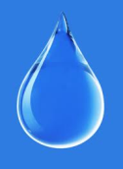
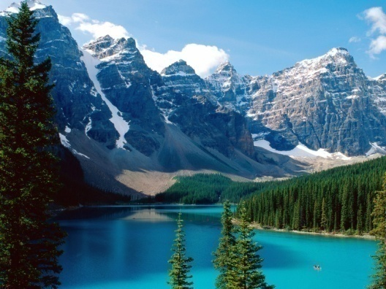
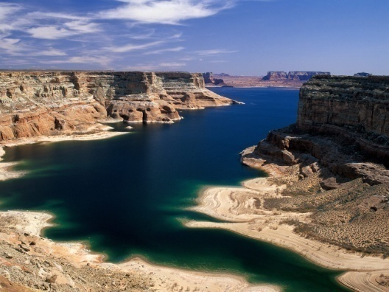
Table of Contents
WATER
Hydrological cycle
Water Forms and Distribution
Types of Water Uses
Watershed Management
Rain water harvesting
Dams and types of dam
Multipurpose Water Resource Management
Conclusion and Recommendation

Slide 3
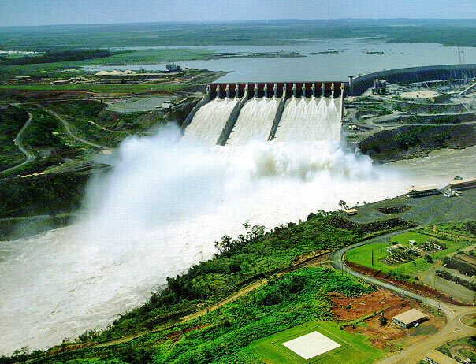
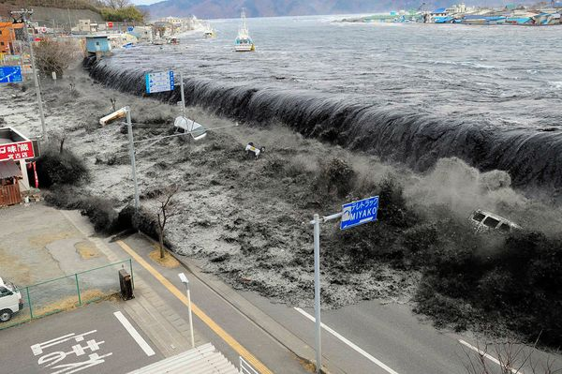
What is Water?
Water is a marvelous substance which may be constructive or destructive depending on its characterstics and climatic conditions.

Slide 4
Hydrological cycle or Watercycle
Hydrological cycle is a process in which the water continiously flows in different forms in the enviromental components.
Major parts of water cycle:
(1)Evaporation
(2)Transpiration
(3)Precipitation
(4)Infiltration or Percolation
(5)Runoff

Slide 5
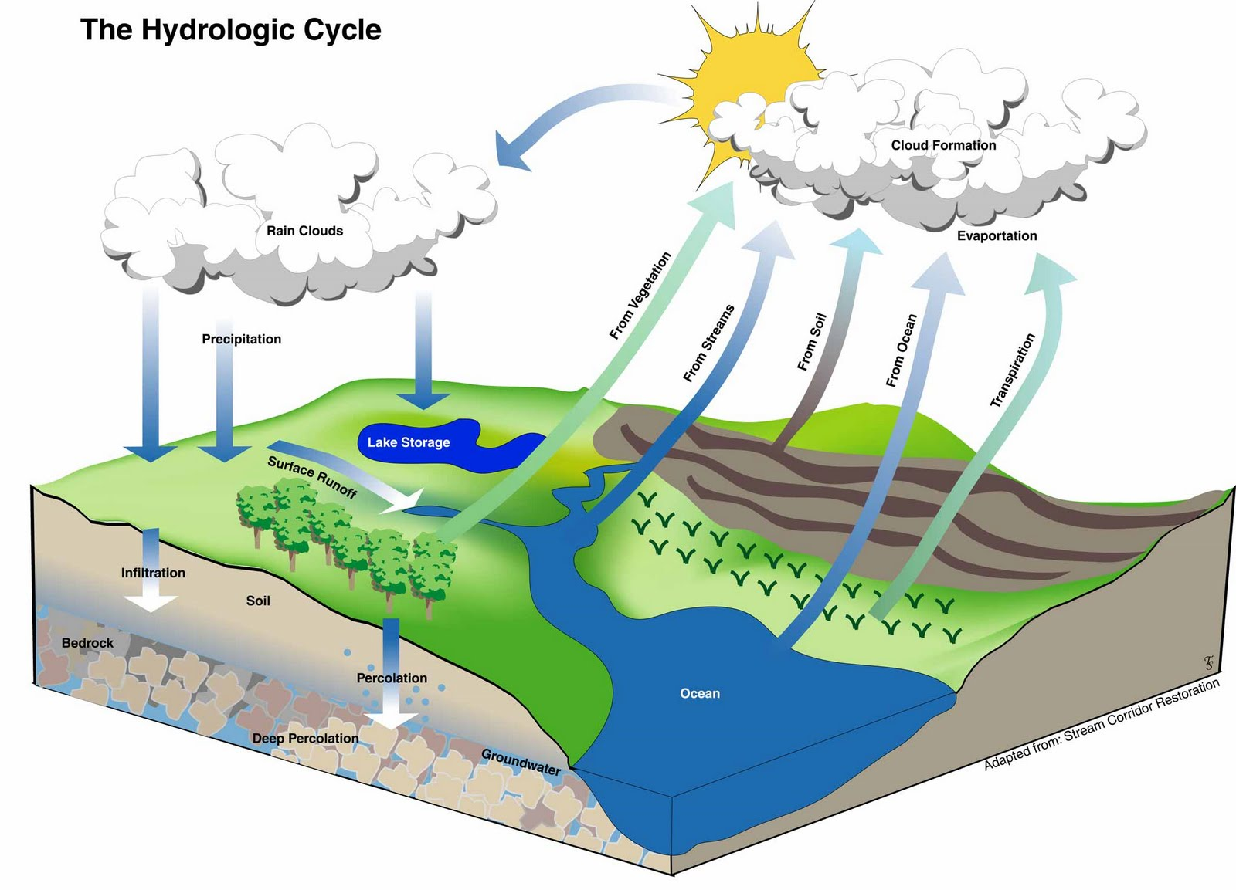
Hydrological Cycle

Slide 6
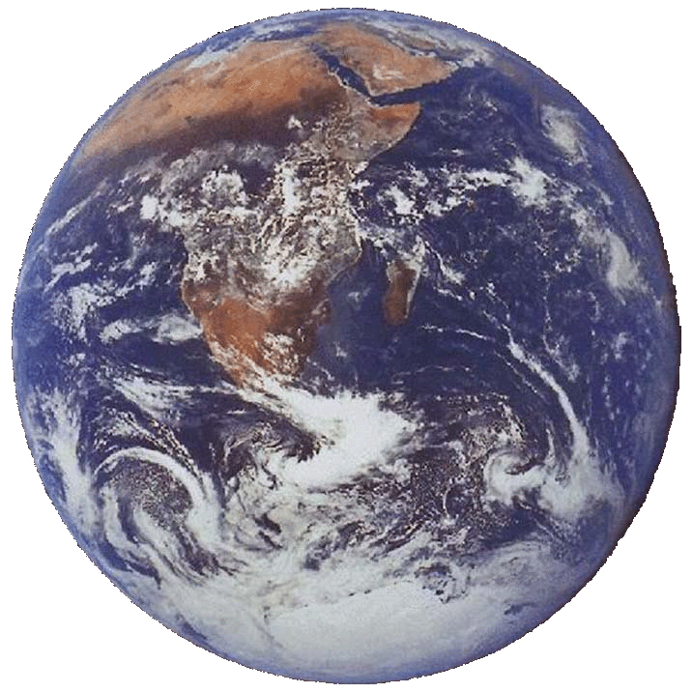
Water Forms and Distribution
About 71% of the earth’s surface is covered with water.

Slide 7
Types of water resources
OCEAN
ICE AND SHOW
GROUND WATER
RIVERS AND STREAM
WETLAND AND SOIL MOISTURE
ATMOSPHERE

Slide 8
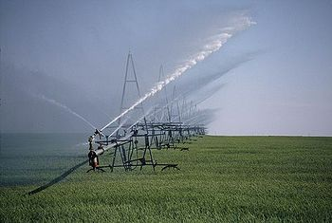
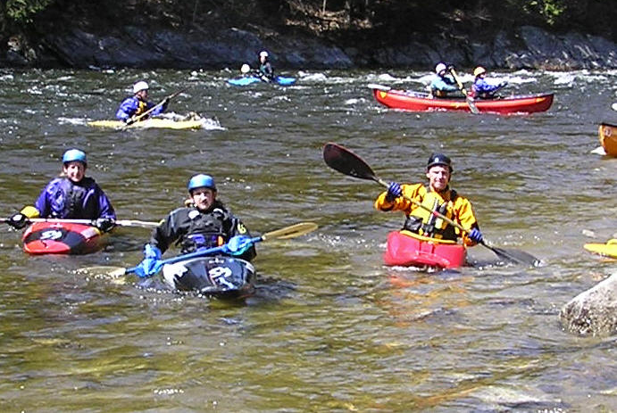
Types of Water Uses
Off-Stream Uses
Agriculture
Thermoelectric
Industrial
Mining
Domestic
Commercial
Notes:
http://commerce.wi.gov/ie/IE-MexicoWaterReport-2011-Winter-Article-AgricultureWater.html
http://www.chinawaternexus.com/?p=207
http://www.fao.org/nr/water/aquastat/countries_regions/cambodia/index.stm

Slide 9
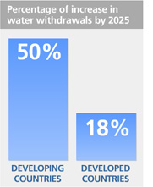
Types of Water Uses
Basic Assumption (by UN Water)
Source: World Water Assessment
Program (WWAP)
Source: Food and Agriculture
Organization (FAO)

Slide 10
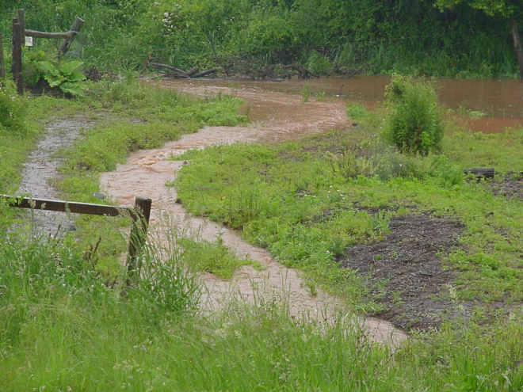
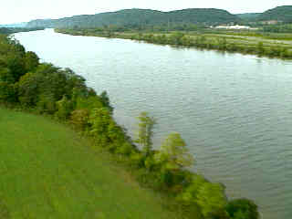
Watershed Management
Watershed – the definition
A watershed is a connected series of streams, rivers, and lakes that collects water from a specific area of land.
Watersheds are important habitats for animals and plants, and offer a source of drinking and recreational water for many communities.

Slide 11
Watershed Management
Objectives:
The rehabilitation of degraded lands.
The protection of soil and water resources under land use systems that produce multiple products of the land.
The enhancement of water quantity and quality.
Strategies:
Managing Watershed Land-Use Practice
Managing Riparian Areas
Vegetation-Type Conversion
Water Harvesting
Water Spreading

Slide 12
RAIN WATER HARVESTING
It is the activity of direct collection of rain water
Rain water can be stored for direct use or can be recharged into the ground water aquifer

Slide 15
DAMS
Dam is a solid barrier constructed at a suitable location across a river valley to store flowing water.
Storage of water is utilized for following objectives:
Hydropower
Irrigation
Water for domestic consumption
Drought and flood control
For navigational facilities
Other additional utilization is to develop fisheries

Slide 16
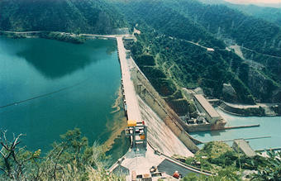
DIFFERENT TYPES OF DAMS
GRAVITY DAM
These dams are heavy and massive wall-like structures of concrete in which the whole weight acts vertically downwards.
As the entire load is transmitted on the small area of foundation, such dams are constructed where rocks are competent and stable.

Slide 17
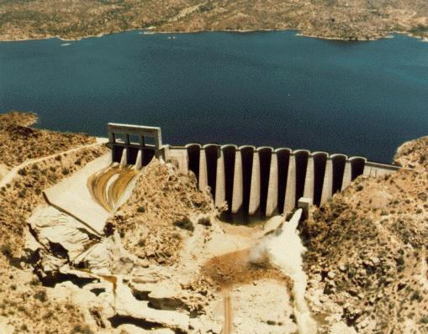
BUTTRESS DAM
Buttress Dam – Is a gravity dam reinforced by structural supports
Buttress - a support that transmits a force from a roof or wall to another supporting structure

Slide 18
ARCH DAM
These type of dams are concrete or masonry dams which are curved or convex upstream in plan
This shape helps to transmit the major part of the water load to the abutments
Arch dams are built across narrow, deep river gorges, but now in recent years they have been considered even for little wider valleys.

Slide 20
EFFECT OF OVER USE OF WATER
Water resources is EVERYONE’s concern!
The consumption has been increased significantly due to population growth.
Water availability is decreasing due to human overuse and natural degradation.
Many sources of water have become unusable.
Allegedly control over water lead to intraboundary and transboundary conflicts.
Effective water resource management and policy must be implemented on both local and international levels.

Slide 21
Tips on How to Save Water
Increasing water resources start from all of us!
Don’t flush every time you use the toilet.
Take shorter showers
Don’t wash your car so often.
Don’t let the faucet run while washing hands, dishes, food, or brushing your teeth.
Don’t run the dishwasher when half full.
Dispose of used motor oil, household hazardous waste, batteries, etc., responsibly.

Slide 22
THANK YOU

